Slide 1
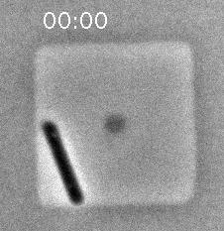
Eun, Garner, Amir, Schmid, et al, Nature Microbiology 2018
Notes:
First real-time imaging setup for extremophiles, archaea.

Slide 2
Microbes and Math
J-term 2023
Growth introduction
2023-01-18

Slide 3
What we’ll talk about today
Nutrients and media
Logarithmic growth
Measuring cell growth
Culturing methods

Slide 4
The laws of thermodynamics
Energy can be neither created or destroyed.
Entropy increases.
Entropy is temperature dependent.

Slide 5
How do cells fight entropy?
Metabolism
The sum total of all of the chemical reactions that
occur in a cell
Catabolic reactions (catabolism)
Energy-releasing metabolic reactions
Anabolic reactions (anabolism)
Energy-requiring metabolic reactions
Most of what is known of microbial metabolism is based on study of
laboratory cultures

Slide 6
Nutrients
Supply of monomers (or precursors of) required by cells for growth
Macronutrients
Nutrients required in large amounts (C, N, P, S, etc)
Micronutrients
Nutrients required in trace amounts (e.g. trace metals)
Growth factors (Vitamins, amino acids, purines, pyrimidines)
Notes:
Go to periodic table on the wall and go through which nutrients are important

Slide 7
Types of media
Defined medium
All chemical components added are known
Minimal medium = only those components absolutely required for growth are included
Complex medium
Usually contains tryptone or yeast extract
Medium components are undefined but allow optimal growth.

Slide 8
Biosynthetic capacity
The ability of a microbial species to produce its own nutrients from precursors provided in the medium.
The higher the capacity, the fewer nutrients must be supplied (“simple nutritional requirements”)

Slide 9
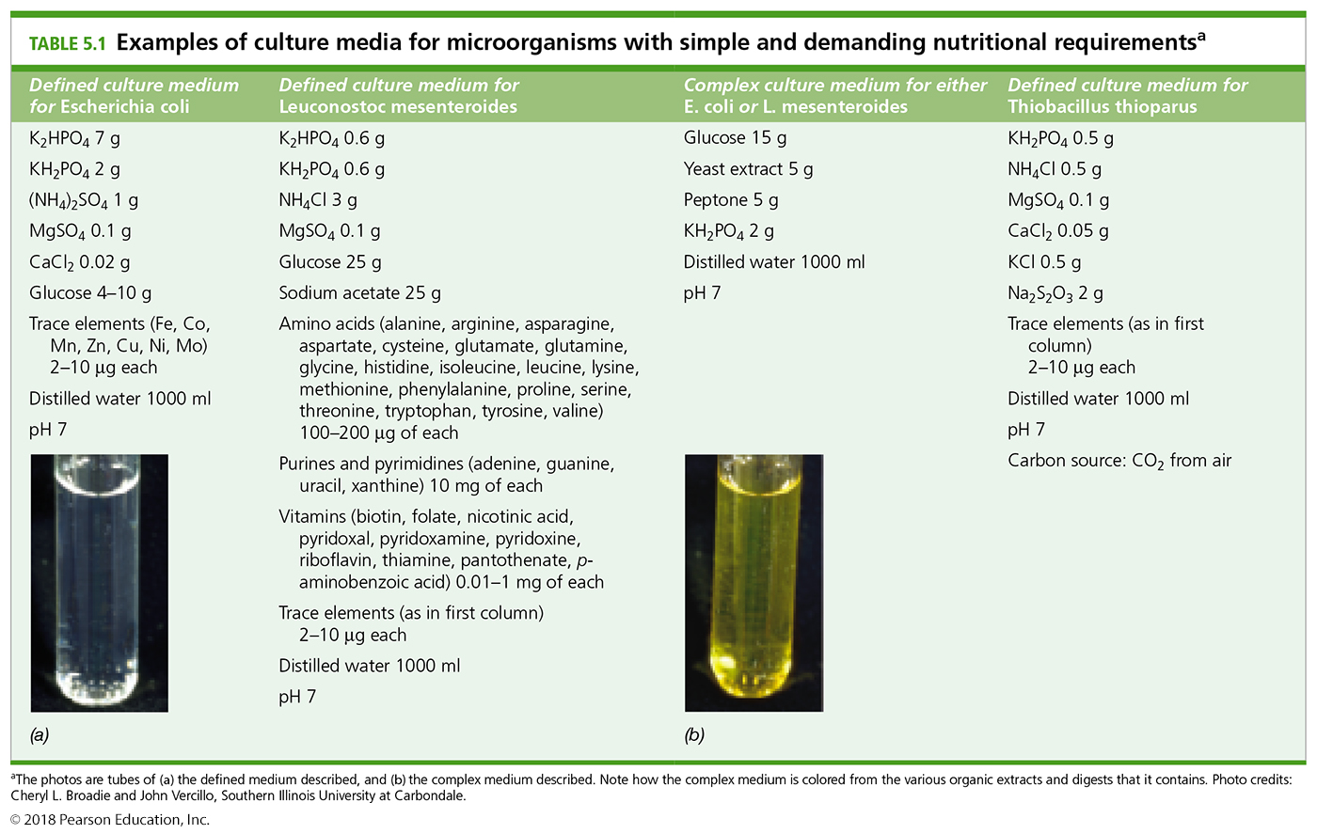
Which microbe has a higher biosynthetic capacity?
P
P
S/N
S
C
C
N
GF
Notes:
Much of this knowledge regarding microbes has been garnered from experimenting with culture growth: add some of this, ask whether it grows and how fast.

Slide 10
Nutritional requirements for bacterial growth
carbon source
- autotrophs: an organism capable of biosynthesizing all cell material from CO2 as the sole source of carbon. (Please note the difference from auxotroph).
- heterotrophs: an organism requiring organic compounds as a carbon source.
energy source
- chemolithotroph: an organism which uses inorganic chemicals as energy sources (electron donors).
- chemoorganotroph: an organism which uses organic chemicals as energy sources (electron donors).
- phototroph: an organism capable of using light as an energy source.
Most eukaryotes either photoautotrophic (plants, algae) or heterotrophic (animals, protozoa, fungi).
Lithotrophy is unique to bacteria and archaea.
Photoheterotrophy, common in purple and green Bacteria, occurs only in a very few eukaryotic algae.

Slide 11
Major nutritional types of prokaryotes

Slide 12
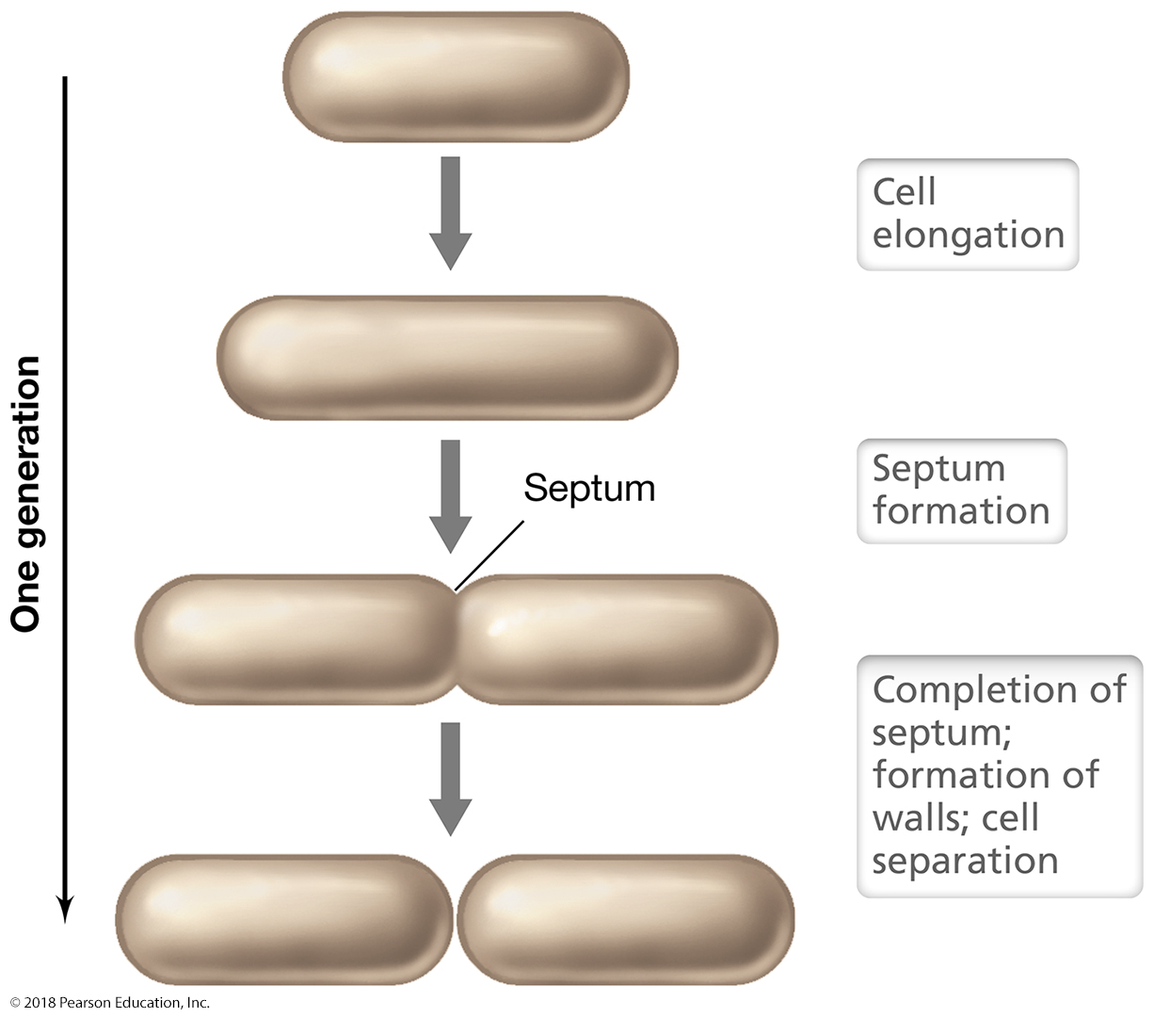
Once they have energy, microbial cells grow by binary fission
Other ways to grow:
Cell cycle (mitosis)
Budding
Fragmentation
Sporulation

Slide 13
Bacterial and Archaeal cells grow by binary fission
Eun, Garner, Amir, Schmid, et al, Nature Microbiology 2018
Notes:
First real-time imaging setup for extremophiles, archaea.

Slide 14
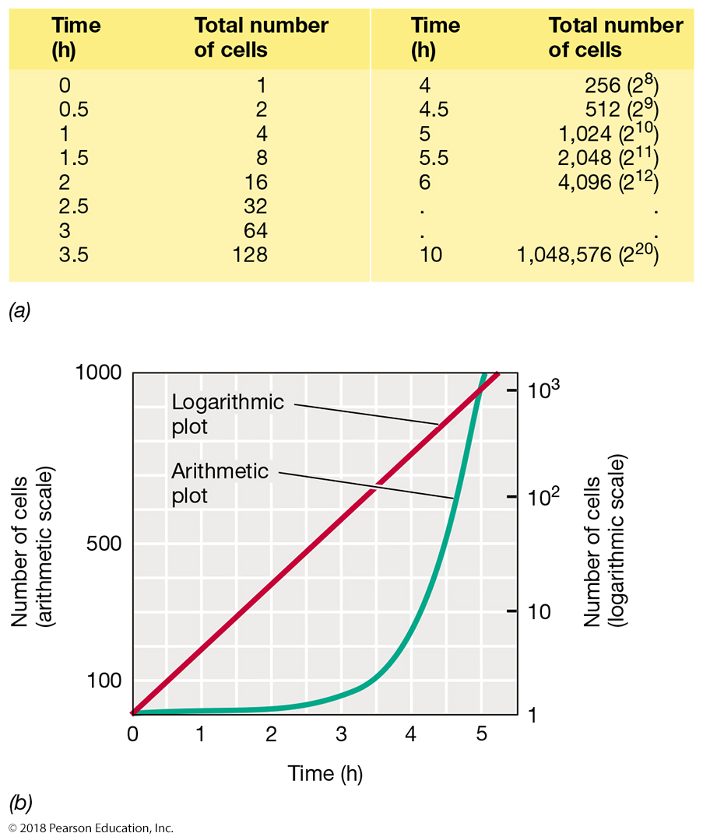
Calculating exponential growth

Slide 15
The four phases of growth
Zweitering et al., 1990, J Bacteriol

Slide 16
Calculating exponential growth
N_{t} = N₀ x 2^{n}
where N_{t} = Number of cells at time t; N₀ = number of cells at start; and n = number of cell generations
Doubling time or generation time - the time needed for a population to double: g = t/n
Division rate – number of generations per unit time (h⁻¹)
Optimal doubling time for E. coli = 20-30 min, for yeast = 1 hr.
In 24 hrs E. coli can divide for 72 generations
= 4.7 x 10²¹ cells!!
log N_{t} = logN₀ + n log2
n = (log N_{t} – logN₀) / 0.301

Slide 17
Calculating growth
A cell culture has grown from OD600 0.25 to 1.0 in 24 hours. What is its generation (doubling) time? How many generations have elapsed?
n = (log N_{t} – logN₀) / 0.301
g = t/n
n = 2
g = 12 hrs
Notes:
Also mention milk spoiling fast as a practical example of logarithmic growth.

Slide 18
Cell growth in the lab
Batch culture – Growing cells together in a flask in a liquid nutrient broth.
Plate growth – Growing cells in individual colonies on a solid support (agar)
Chemostat culture (continuous culture) – growing cells at a fixed growth rate with controlled inflow and outflow of medium, where the medium supplied is limiting for a required nutrient (e.g. sugar).

Slide 19
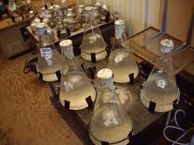
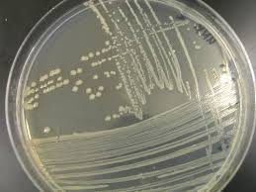
Growing cultures in the lab
BATCH
PLATE

Slide 20
Monitoring cell growth
Culturable organisms
Direct counts (e.g. hemocytometer)
Plate counts (aka viable counts)
Spectrophotometer
Unculturable organisms
Genetic methods
Environmental probing and enumeration
FACS

Slide 21
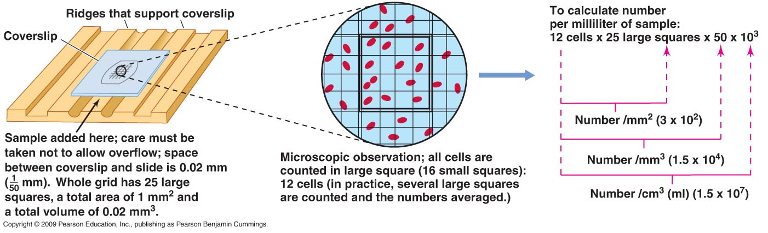
Direct counts – used frequently for environmental samples
Advantages
Quick and easy
Get direct counts
Disadvantages
Requires staining to distinguish live/dead
Motile organisms must be immobilized
Doesn’t work well at low densities

Slide 22
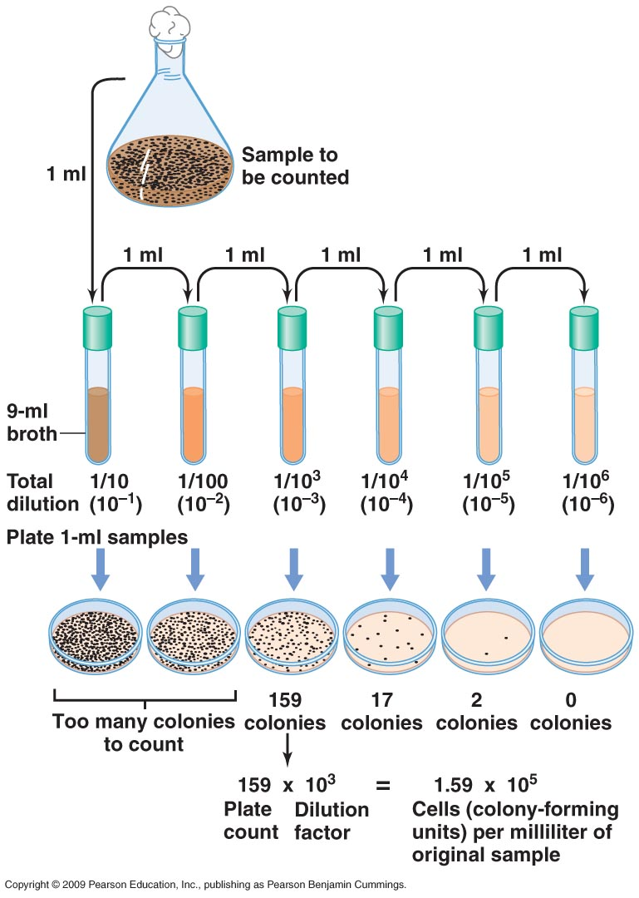
Plate counts
Advantages
Can distinguish live/dead
Reliable counts when growth
conditions are known
High sensitivity
Disadvantages
Highly misleading for mixed
cultures (the Great Plate
Count Anomaly)
Can take a long time for
slower-growers
Can’t be used for unculturable organisms

Slide 23
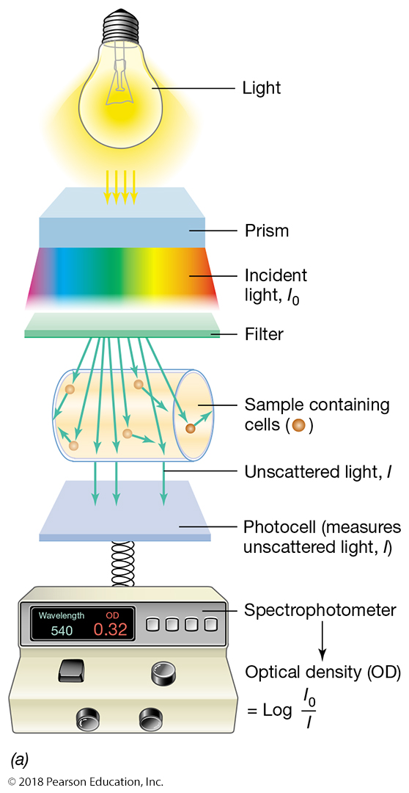
Spectrophotometer
Advantages
Sensitive
Can be done on live
cultures
Quick and easy
Proportional to direct counts
Can use the instrument for
quantifying other samples
(e.g. DNA, protein, enzyme
activity)
Disadvantages
Does not distinguish live/dead
unless there is lysis.
Misleading if clumps or flocs

Slide 24
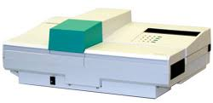
The Bioscreen
High throughput growth curves
200 at once, automated readings every 30 mins

Slide 25
The four phases of growth
Plate counts (viable count) and spec (OD or turbidity) might yield different answers
For log phase, stat phase, and death phase, but they should yield the same
Growth rate for exponential phase. That’s why microbial physiology is usually
Determined by growth rate in exponential phase – “balanced growth”

